Slide 1
Year 6 Residential
Wednesday 4th June – Friday 6th June 2025

Slide 2
Year 6 Residential
Wednesday 4th June – Friday 6th June 2025 (2 nights)
Leaving St George’s Primary School 9.15am approx by mini-bus.
Arrive at school 8.30-8.45am with packed lunch for that day.
Return to school Friday 6th June for the end of the school day. 3.15pm.
Personal Development
Types of activities
Kit List
Meals
Sleeping Arrangements
Communication
Moor House Adventure Centre

Slide 4
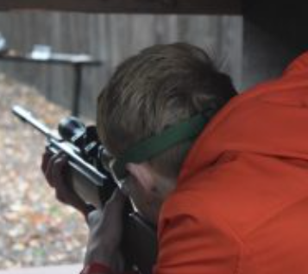
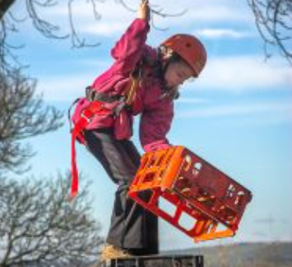
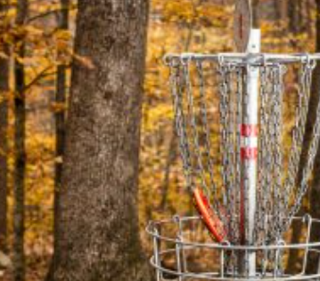
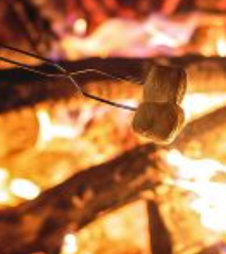
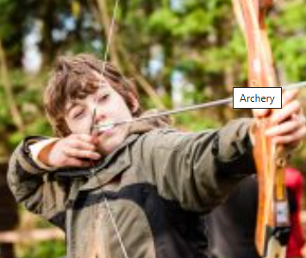

Slide 5
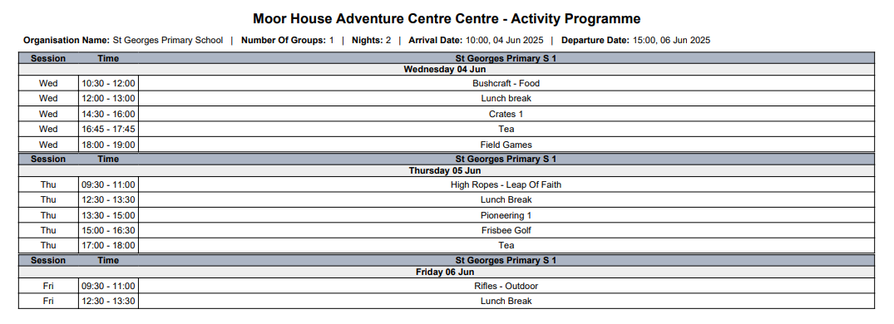
The activities are not ‘set in stone’ and are subject to change.

Slide 6
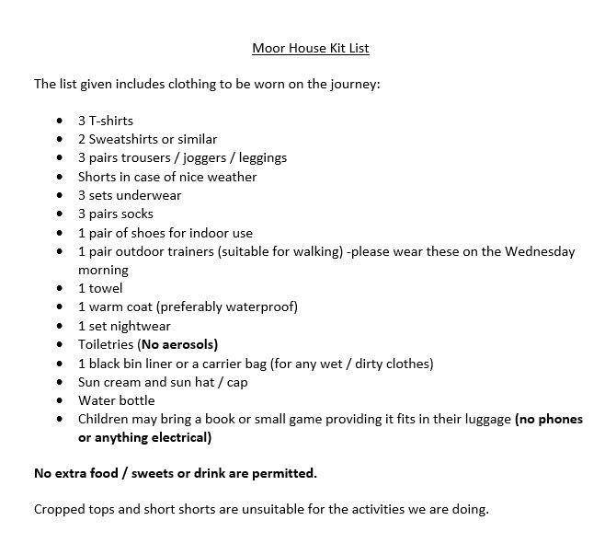
Children will also require a sleeping bag/single duvet and a pillow

Slide 7
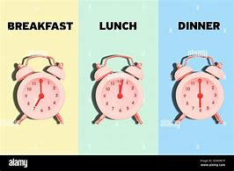
Meals
Breakfast, Lunch & Dinner are provided.
Suggested menu often includes sausage& mash / spaghetti bolognese.
Lunch – sandwiches, crisps, dessert, biscuits, fruit etc children select their choice.
School provide additional snacks and supper such as toast, crisps etc.
Dietary requirements are shared with the venue.
Additional discussions regarding meal times can be arranged with school.

Slide 8
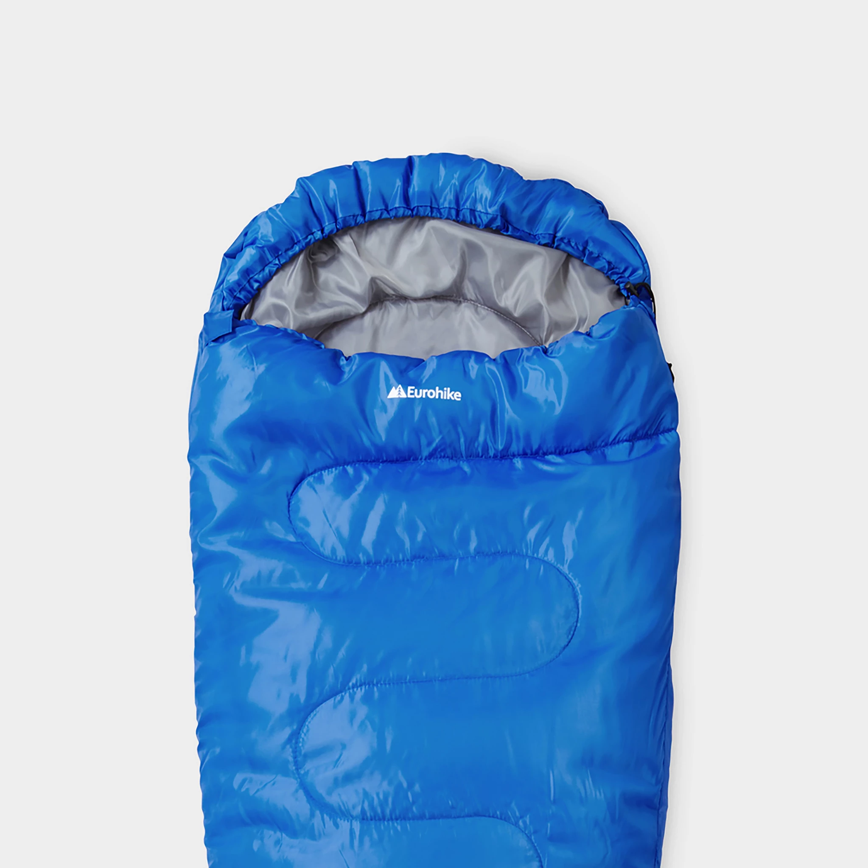
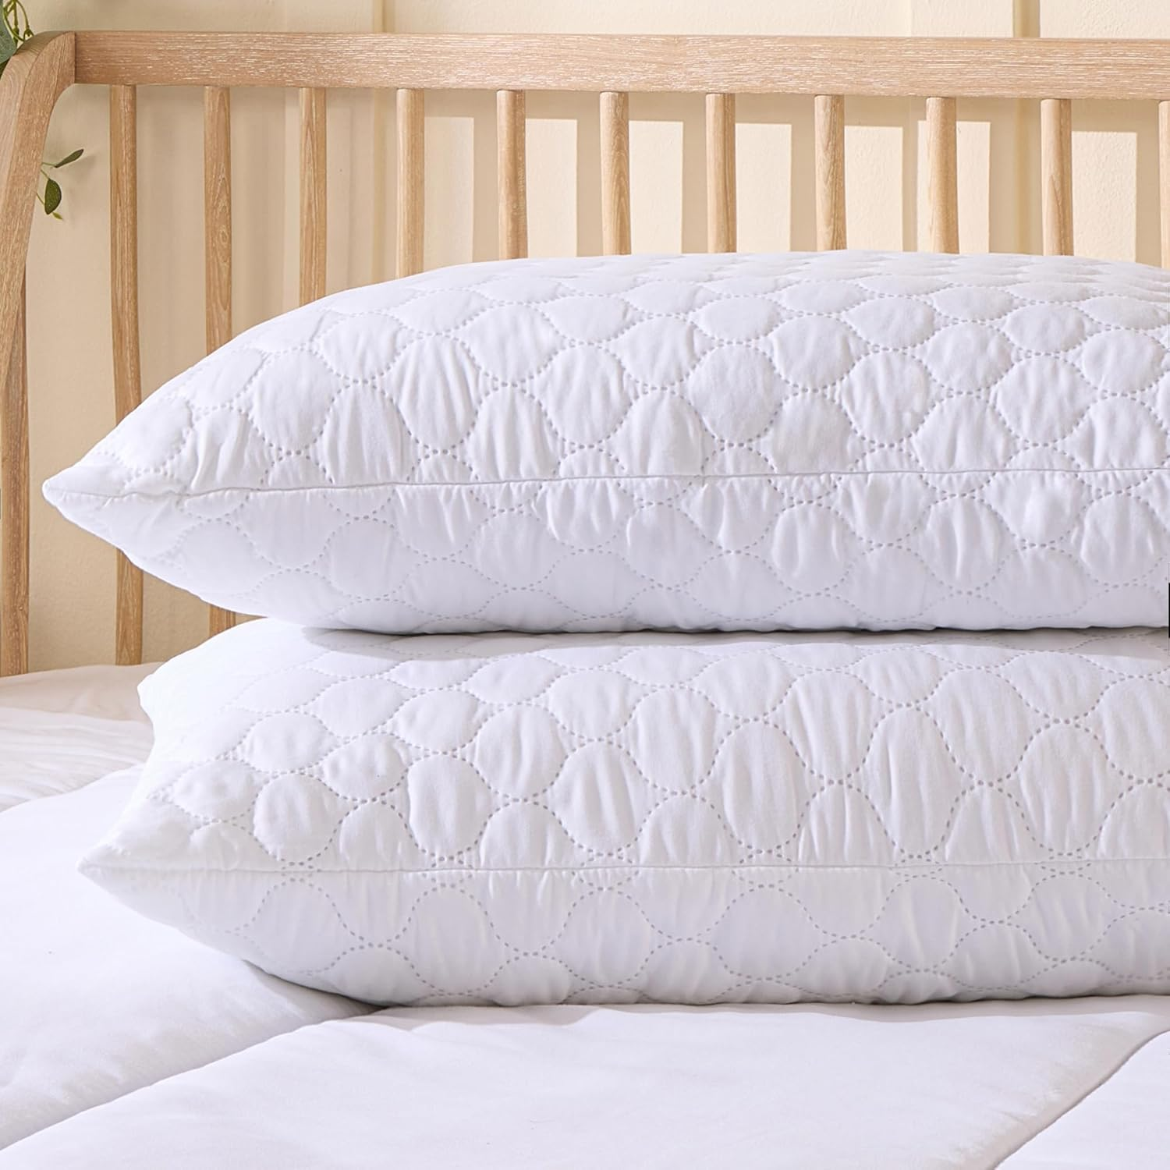
Sleeping Arrangements
1 man pop-up tents indoors.
Several shared dorm rooms.
Boys/Girls to sleep in separate spaces supervised by school staff.
No pupils are allowed in bedrooms/sleeping spaces unsupervised during the visit.
Toileting concerns, please arrange a meeting to discuss.
Main hall - communal

Slide 9
Communication
Facebook updates.
School text message.
No direct communication between Moorhouse & Families.

