Slide 1












Resources to support parents in relation to their child’s emotional wellbeing
Your school/organisation’s logo:

Slide 2







Supporting your children and young people to manage their emotions and improve their mental wellbeing
www.childrenengland.org.uk/children-north-east
Children North East
A charity that helps and support families through a range of different programmes
Young minds
Parenting guide to supporting your child
Practical advice for parents to support their child in regards to their mental health and wellbeing. This resource also provides a parent helpline
Young minds
Parent support around your child expressing suicidal thoughts
A useful resource to help build understanding, confidence in talking about poor mental health and suicidal thoughts. Where you as a parent can access support for your child, and how to respond and what steps to take if your child reports to feel suicidal
www.youngminds.org.uk
www.youngminds.org.uk

Slide 3




www.youngminds.org.uk
Young minds
Gender Identity and Mental Health
Support for parents in relation to children and young people’s gender identity, how this can impact and effect mental health, how you as a parent can support your child and where you can seek professional health
Transformation partners in health and care
Resources and support for parents in relation to LGBTQI+ and mental health
FFLAG
Support for families and our LGBT+ loved ones with pride.
Access to resources, support, news and downloads to help build understanding and confidence
www.transformationpartners.nhs.uk
www.fflag.org.uk

Slide 4






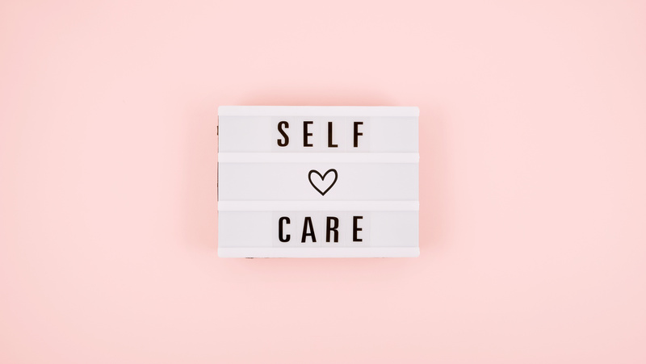
www.charliewaller.org
The Charlie Waller trust
There is practical advice, support and training parents can access through the trust. This has support and advice in regards to child depression, anxiety, self harm, and managing difficult feelings. This is not an exhaustive list
The Anna Freud centre
A valuable resource to support parents and carers in relation to their child’s mental wellbeing
Early help support
Early help is a support service for children, young people and their families. Early help can provide support around family relationships/conflict, children and young people and their emotional wellbeing, parental mental wellbeing, financial strain/ concern, attendance, routines, boundaries and family support. This is a voluntary service and does not involve social services. You are entitled to end the support at any time
Mind
Mind will support you as a parent to look at the challenges you face, how you can ensure you take care of you and where to find and seek support
www.annafreud.org
www.mind.org.uk

Slide 5




www.nhs.uk/every-mind-matters/
Every mind matters
Dedicated support to help support parents/guardians look after the mental wellbeing of their children
Your GP
Your GP can support you as a parent/carer around how you are feeling and seeking support. They can also provide support and advice in regards to seeking specialist emotional wellbeing support for your child. Your GP can also refer to valuable services in regards to sleep, enuresis, special educational needs and body health
CYPS/CAMHS (Name will depend on the area you live)
A specialist service in relation to child and young person mental health. This service can also provide assessment in regards to children where there are concerns around special education needs and disabilities such as Autism, ADD, ADHD ETC
Barnardos
Online support and counselling for young people and their families
www.barnardos.org.uk

Slide 6





BBC bitesize: School anxiety and refusal
Advice guidance and support if you as a parent/carer are struggling to get your child into school
Anti-Bullying Alliance
www.anti-bullyingalliance.org.uk
The Anti-Bullying Alliance is a coalition of organisations and individuals that are united against bullying. This website provides parents/carers with support in relation to bullying
BEAT
www.beateatingdisorders.org.uk
BEAT offer a range of services for those affected by eating disorders. From support for young people to support for family and friends of someone who may be suffering from an eating disorder
This resource is for supportive purposes and does not replace medical advice

Slide 7
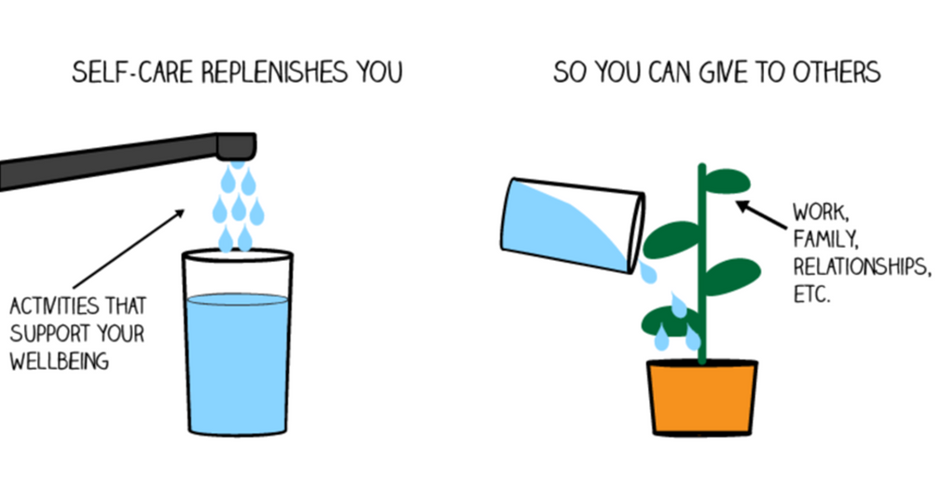


Please ensure you seek the necessary support from services to meet your own health and wellbeing
Looking after YOU is important

