Slide 1
Welcome Year 2 Parents
2023/2024

Slide 2
Morning Routines
Hang things up
Reading records and books in trays
Breakfast
Morning Task

Slide 3
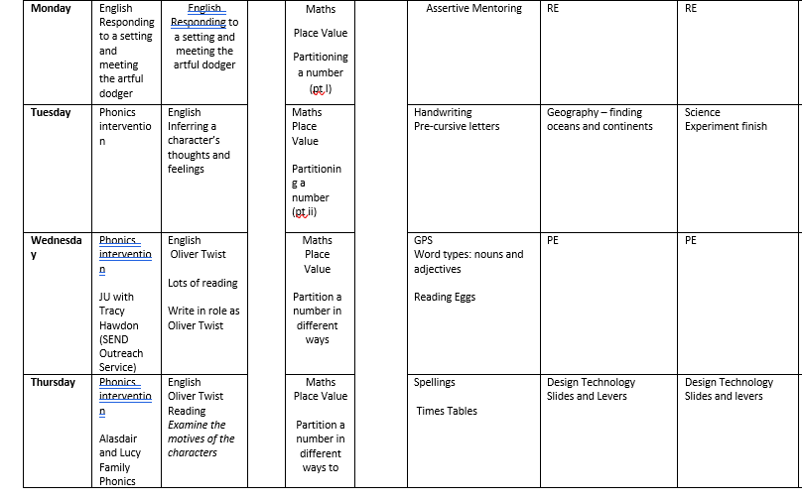
Year 2’s timetable

Slide 4
Break Times
Year 2 use the main yard for morning, lunch and afternoon play and have access to PE equipment at lunchtimes.
Children have a selection of fruit/vegetables that they can enjoy.
We encourage the children to use the toilets as they come into school and during break times.

Slide 5
Dinner Times
Packed lunches and school dinners sit together in the hall
Most days, children have 4 meal options for their school dinners (+ a salad bar)
School requires (at least) a week’s notice of a change between school dinners and packed lunches

Slide 6
School Uniform
Please ensure your child has plain black shoes or trainers to wear for school and a separate pair of plain trainers for PE
No jewellery is to be worn apart from simple, plain stud earrings, which must be removed for PE (or covered with plasters if this is not possible)
Hair must be tied back from a child’s face.
Please write your child’s name on everything.

Slide 7
Illness
If your child is too ill to attend school, please contact school office as soon as you can
Please keep your child at home if they have a temperature
Medicines – handed in to an adult, not kept in children’s bags
Medical form only available from office
Inhalers/Epipens kept in classrooms

Slide 8
PE
This half-term we are doing PE on a Wednesday.
Children to come to school in P.E. Kits (all plain & named)

Slide 9
Reading
It is important to your child’s learning that they are heard reading by an adult every day, even if it is for a few minutes
Please sign your child’s reading record
You can read personal books
Children are encouraged to access Reading Eggs at home every week.

Slide 10
Reading
Please put your child’s book in their bag every day.
We aim to change reading books weekly
We aim to hear each child read individually at least once a week
We use ‘Class Novels’ to support reading, these are books that we read as a whole class and use as a focal point for our work

Slide 11
Maths
By the end of Year 2 the children should be able to recall the multiplication and related division facts of the 2, 5, 10
They will have a weekly assessment called a ‘Skills Check’
Children are encouraged to use Times Tables Rock Stars at home weekly, at least.

Slide 12
Homework
Reading Daily (please comment so we can keep track)
Spellings weekly – given out on a Friday and tested on a Thursday
Times tables weekly – given out on a Friday and tested on a Thursday

Slide 13
SATs
These are assessments that will be carried out in May 2024.
They are no longer statutory.
The assessments are in English, maths and Spelling, Punctuation and Grammar
All children in Year 2 will sit the assessments, unless it is apparent that a child cannot access the material.

Slide 14
Behaviour management
Cubes
Greenies
Golden Time

Slide 15
Please speak to us If you have any concerns whatsoever!
Leave a message on the door in the mornings or catch us at the end of the day
Make an appointment for a longer meeting if necessary

Slide 16
School Website
https://www.stgcps.org/web
The school website is where you can access all of the learning support and learning at home materials

